Slide 1
Brain Teaser-The Game
Presented by
Dipesh Shrestha
1NH17CS039

Slide 2
OBJECTIVES
To top up users brain with IQs & non-bookish knowledge
To enhance their problem solving skills
To increase their thinking power
To make proper utilization of the leisure time
To get rid of games having unreliable content

Slide 3
OOPS CONCEPT
INHERITANCE:
Brain- Teaser makes use of single inheritance by reusing the data members and member functions of the base class and extending it with friend function and overloaded functions.
POLYMORPHISM:
This project makes use of compile time and run time polymorphism concept by including function overloading and pure virtual function.
FRIEND FUNCTION:
Brain – Teaser makes use of it in comparing the two objects/players to get the final result.
PURE VIRTUAL FUNCTION:
Brain – Teaser makes use of it to attain abstract class and overridden in the derived class.

Slide 4
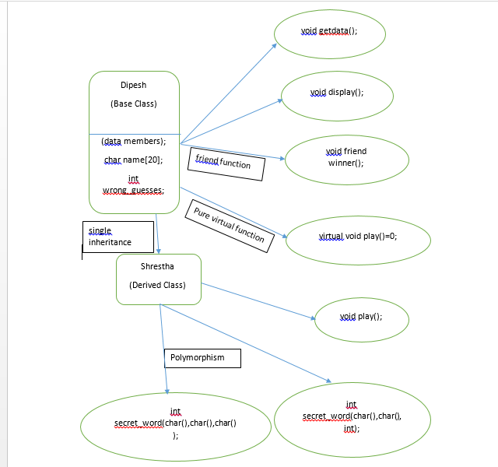
CLASS DIAGRAM

Slide 5
FUNCTIONALITY
FIRST PART:
Brain – Teaser ask for the player information and to guess a number between 1-20.
That guessed number is used to select the element from the array using rand function.
SECOND PART:
The guessed element is encrypted by ‘*’ equals to length of that element.
Player is given a hint and total of five chances to guess that element.
User input is compared with the element letter by letter.
For each wrong guess and repetition of letter their chances is decremented.
THIRD PART:
Same goes for the other player and both objects are passed to the friend function and there after the winner is filtered out on the basis of their number of wrong guesses.

Slide 6
THANK YOU

